Slide 1
St. Louis County Board of Elections Certification Seminar
2020-2021

Slide 2
What’s New?
Mail-in ballots (not in effect for 2021)
Website
www.stlouiscovotes.com
If anything changes with ongoing maintenance, we will let you know

Slide 3
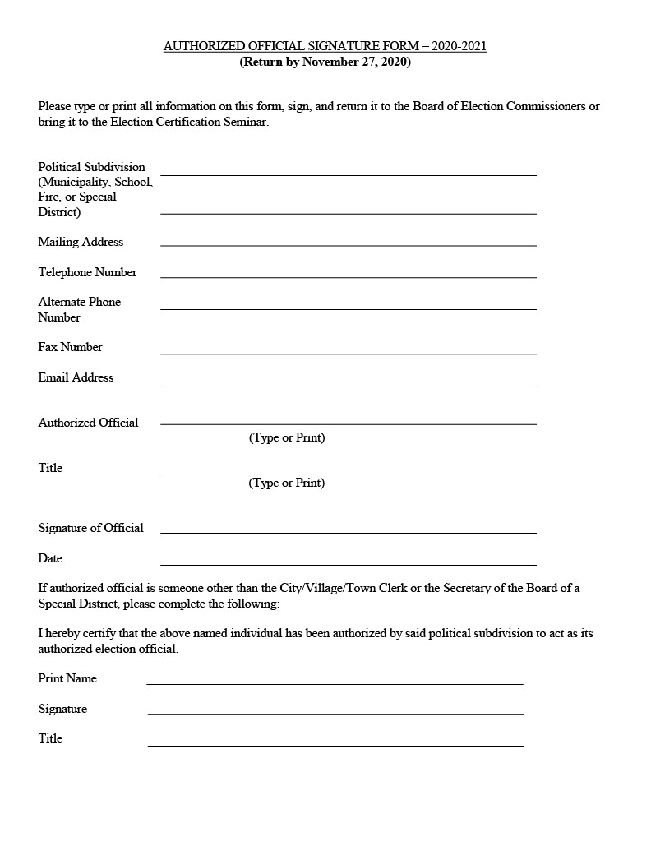
Authorized Officials
Forms due Friday, November 27
Fax, email, or mail
Who is your authorized official?
City/Village/Town Clerk
Secretary of the Board (for school and fire districts)
How can we contact you?
If your office does not have regular business hours, please provide an alternate number (cell phone, etc.)
*keep us updated – important mailed information (certified election results) will
bounce back to us if contact is out of date

Slide 4
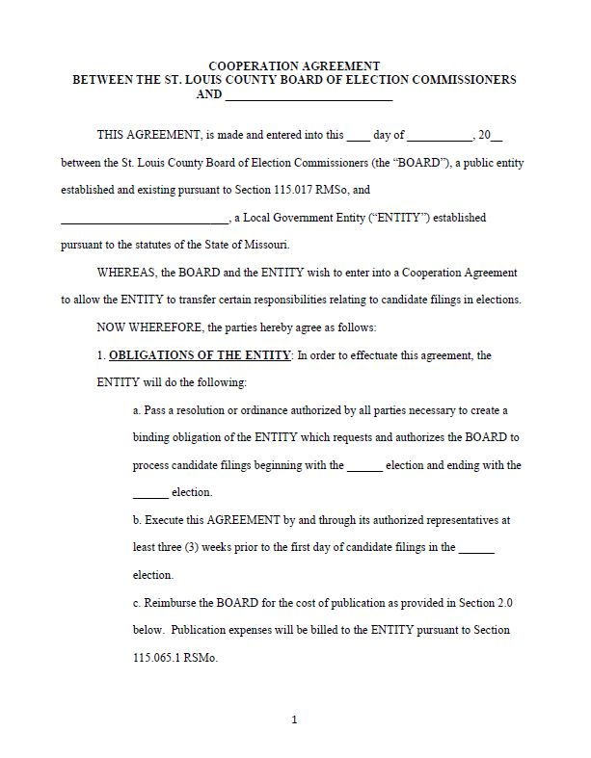
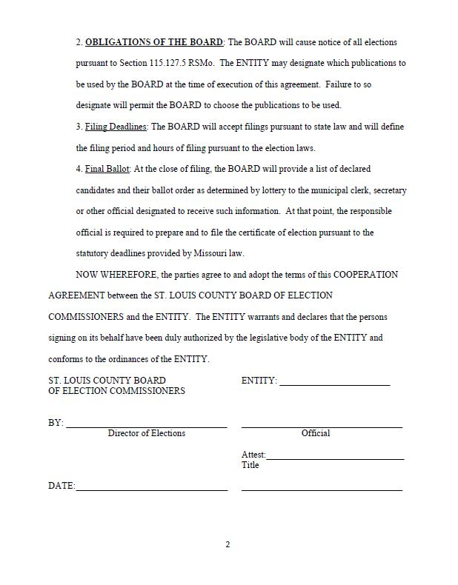
Candidate Filing Cooperative Agreement
Districts may enter into agreement with our office to conduct candidate filing
Voluntary
All candidates file at our office
First day lottery
We will make filing notice
Agreement may be made for one or multiple elections
Must be adopted by ordinance or resolution
Must be executed by November 24th

Slide 5
Candidate Filing
Candidates
Qualifications
Residency
Taxes
Criminal status
It’s helpful to provide a list of requirements to file for your candidates – your ordinances/by-laws may have additional requirements than what is in state statute
Declaration of Candidacy form
Name as to appear on ballot
Form 5120 (DOR)
Affidavit of tax payments and bonding requirements
All candidates must file along with Declaration of Candidacy form
Form 5121 (DOR)
Complaint against a candidate’s 5120 form
Responsibility of complainant to pursue
Withdrawal

Slide 6
Disqualification
DOR
5120 form
MEC
Failure to file a Personal Financial Disclosure form
Circuit court
You are NOT required to verify qualifications unless your district’s ordinances or by-laws provide authority to do so
If you disqualify a candidate and the court finds the candidate to be qualified, additional costs may be incurred
Could lead to a separate election, which would be substantially expensive

Slide 7
Frequently Asked Questions
Deadline
Certification deadline for April 6 election is January 26 (5pm)
Delivery of documents
In-person
Certified mail
Courier
RSMo 115.124 – No Election Required
School and fire districts automatically qualify
Municipalities with <2,000 inhabitants and have passed a proposition may also qualify
If a candidate withdrawals, election must be held
Audio ballots
Used for all elections
Complete audio ballot guide, otherwise we might mispronounce candidates’ names
Write-ins
File at our office, we send notification to entity
Must meet the same qualifications as all other candidates
If no candidate files, all write-ins for that office are valid

Slide 8
More about RSMo 115.124
In order to qualify:
The number of candidates who file for office is equal to the number of positions available
If a candidate withdrawals, you MUST hold the election
Must publish filing in a newspaper of general circulation in the district
Read statute CAREFULLY! If you do not properly publish your filing notification, you MUST hold the election
What you need to certify:
Letter from the district stating it has published the required notice, that the number of candidates equals the number of positions available, a list of candidate(s) that will assume office, and that an election is not needed
Affidavit of publication from the publisher
Copy of the newspaper containing the notice
Publication of Legal Notices form
We will publish a notice containing names of candidates assuming office in newspaper of general circulation
Entity will receive invoice for the cost of this publication

Slide 9
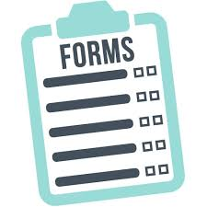
Forms
Certification of Candidates
Ward/district number
Term
Unexpired terms go on a separate sheet
Date and time candidate filed
If you use a lottery, also include the number
No unrelated nicknames or titles
Certification of Proposition
Exact language as is to appear on ballot
Mixed-case
Yes or No
If state law or charter provision specifically provides otherwise, attach a copy of the provision
Audio Ballot Pronunciation
Publication of Legal Notices
Attestation
MUST be signed by authorized official on file with our office
*Please make sure district names and office titles are accurate!

Slide 10
For Reference
Ballot Wording Memo
<50 words
BOE policy regarding ballot changes
Any late candidate or proposition certifications may be opposed by our office in court

Slide 11
Ballot Approval
Ballot Content Report
Ballot Approval Form
Proof the ballot content report against your certifications
If any corrections are needed, sign and send form back before given deadline
Remember: this form is to proof what you have certified is the same as the ballot, NOT to make last minute changes to your certifications

Slide 12
When To Call Your Attorney
Qualifications
5120 forms
Disqualification (MEC or DOR)
Ordinances
By-Laws
Withdrawals
After certification deadline
Late Certification
Certifications after deadline must have a court order

Slide 13
Missouri Ethics Commission
Upcoming filing deadlines and reminders
Campaign Finance Seminar
Personal Financial Disclosure form
BOE/MEC contact information
mec.mo.gov (seminar, webinars, tutorials)
Reporting penalties
RSMo 130.071

Slide 14
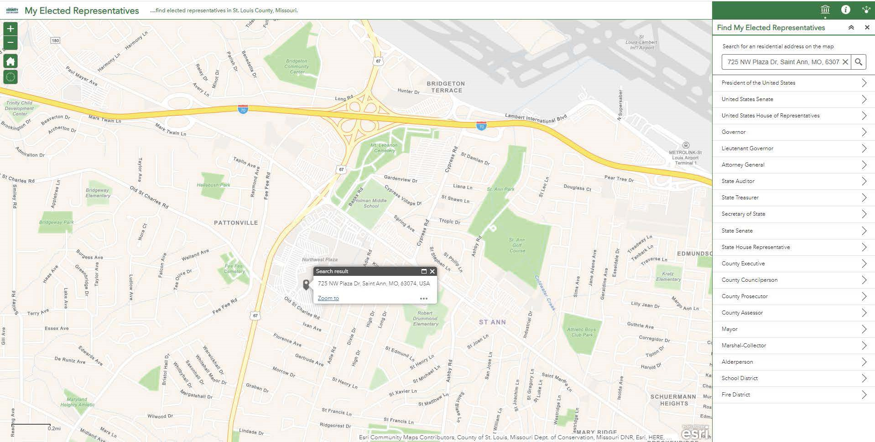
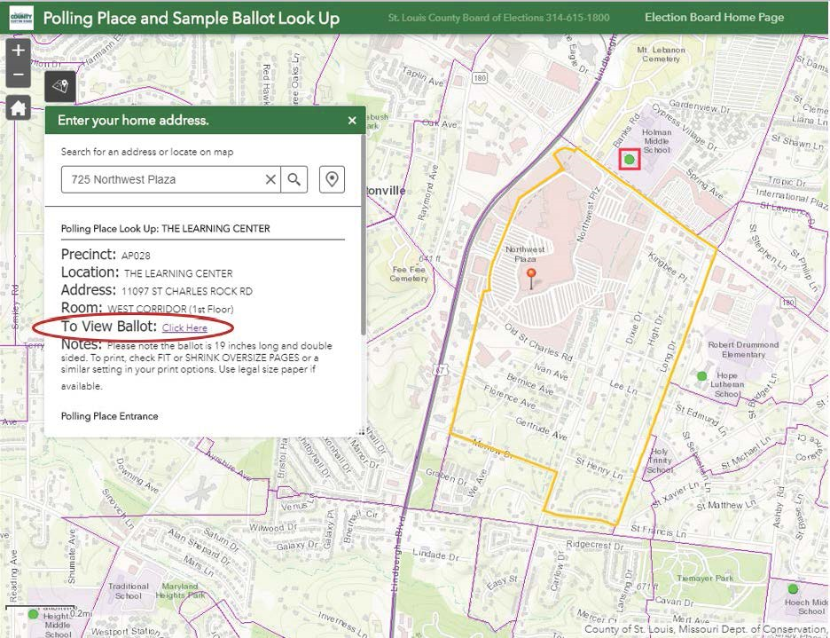
In Closing
Election calendar
Website
www.stlouiscovotes.com
Absentee and military/overseas voting
Election worker portal
Polling Place Look-Up and Sample Ballot application
Find My Representative application
Legislative changes
www.mo.gov

Slide 15
Questions? Unmute yourself or type in the chat box!

